Slide 1
CV reading team3
2022/04/05

Slide 2
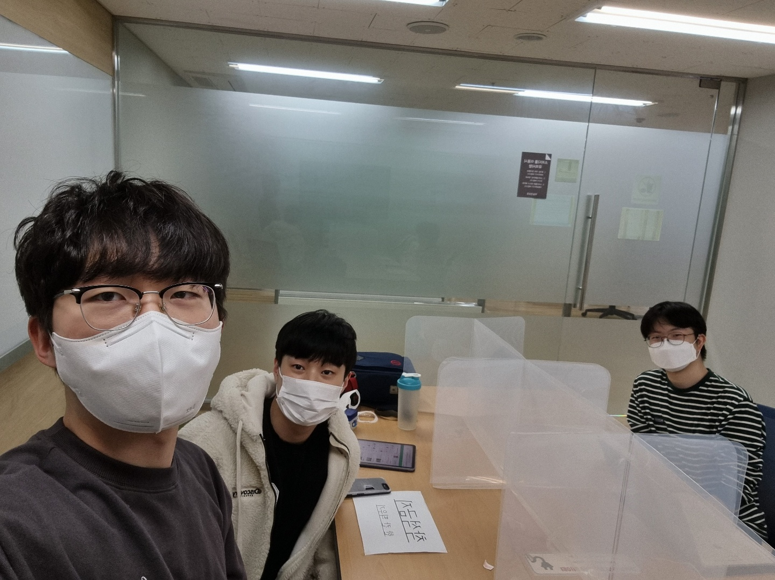
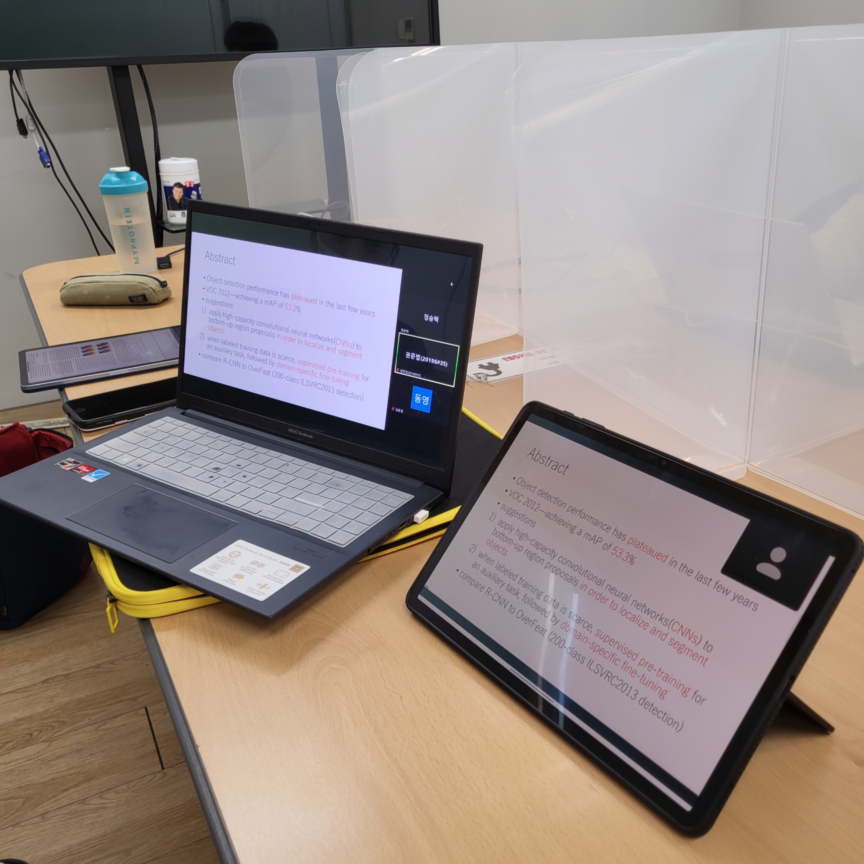
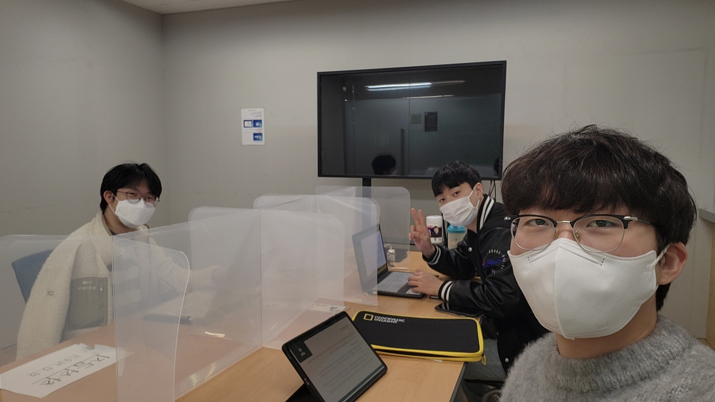
2022/03/23
2022/03/30

Slide 3
Rich feature hierarchies for accurate object detection and semantic segmentation
Ross Girshick, Jeff Donahue, Trevor Darrell, Jitendra Malik
UC Berkeley

Slide 4
Abstract
Object detection performance has plateaued in the last few years
VOC 2012—achieving a mAP of 53.3%
suggestions
apply high-capacity convolutional neural networks(CNNs) to bottom-up region proposals in order to localize and segment objects
when labeled training data is scarce, supervised pre-training for an auxiliary task, followed by domain-specific fine-tuning
compare R-CNN to OverFeat (200-class ILSVRC2013 detection)

Slide 5
Introduction (1)
a representation we could associate roughly with complex cells in V1, the first cortical area in the primate visual pathway.
SIFT and HOG are blockwise orientation histograms
But recognition occurs several stages downstream (hierarchical, multi-stage processes)
Fukushima’s “neocognitron”; biologically inspired model for pattern recognition
Hierarchical
lacked a supervised training
→ CNN (stochastic gradient descent via backpropagation) (LeCun)

Slide 6
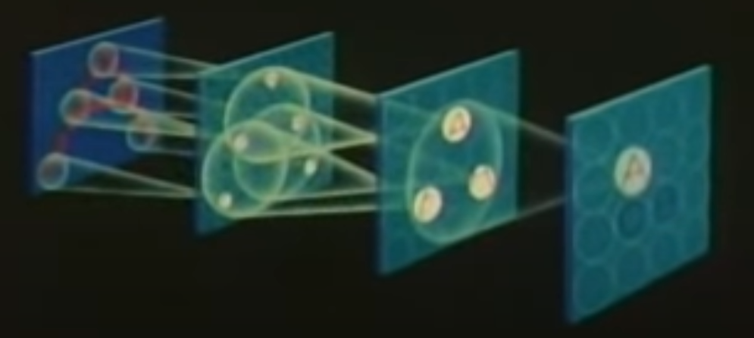
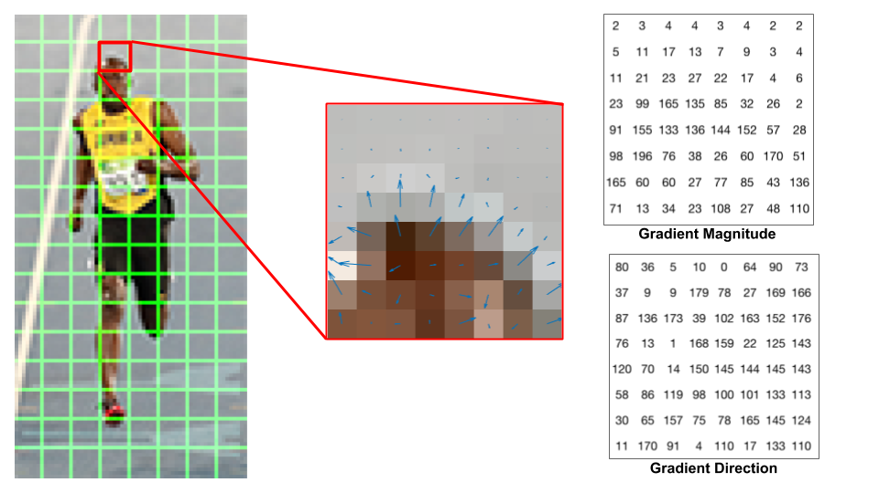
Introduction (1)
heavy use in the 1990s, but fell out of fashion with the rise of support vector machines
higher image classification accuracy in ILSVRC 2012 (Krizhevsky)
Neocognitron Movie - Part #1 - YouTube
Histogram of Oriented Gradients explained using OpenCV

Slide 7
To what extent do the CNN classification results on ImageNet generalize to object detection?

Slide 8
Introduction (2)
The first to show that a CNN can lead to dramatically higher object detection performance on PASCAL VOC as compared to systems based on simpler HOG-like features.
two problems:
localizing objects with a deep network
training a high-capacity model with only a small quantity of annotated detection data

Slide 9
Introduction (3) - localization
localization as a regression problem
- this strategy may not fare well in practice (Szegedy et al.)
sliding-window detector
- to maintain high spatial resolution, these CNNs typically only have two convolutional and pooling layers
- our network have very large receptive fields (195x195) and strides (32x32) in the input image
“recognition using regions” paradigm + affine image warping
→ R-CNN: Regions with CNN features

Slide 10
Introduction (3) - train
scarce and the amount currently available is insufficient for training a large CNN
- conventional solution: unsupervised pre-training (using AE)
- supervised pre-training, followed by domain specific fine-tuning
→ effective paradigm for learning high-capacity CNNs when data is scarce

Slide 11
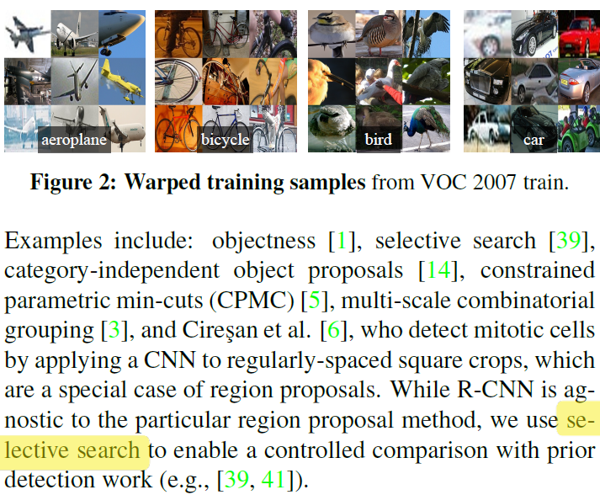
Region proposals
While R-CNN is agnostic to the particular region proposal method, we use selective search to enable a controlled comparison with prior detection work.

Slide 12
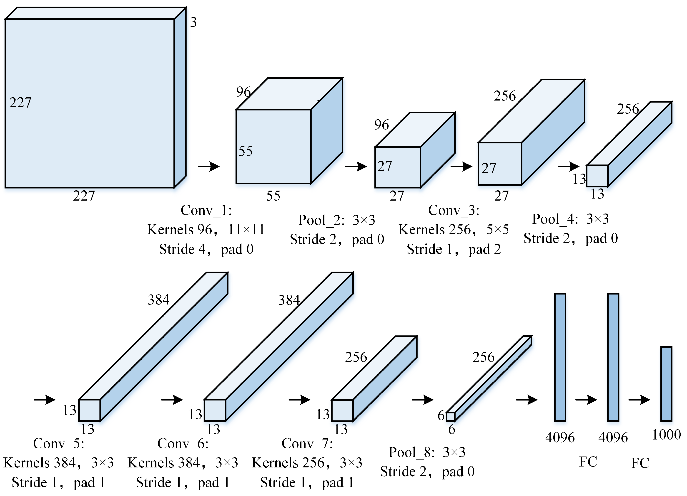
Feature extraction
4096-dimensional feature vector from each region proposal
forward propagating a mean-subtracted 227x227 RGB image through five convolutional layers and two fully connected layers

Slide 13
Test-time detection
selective search on the test image to extract around 2000 region proposals
warp (Appendix A) each proposal and compute feature (forward propagate it through the CNN)
score each extracted feature vector using the SVM
greedy non-maximum suppression

Slide 14
Run-time analysis
Two properties make detection efficient
All CNN parameters are shared across all categories
The feature vectors are low-dimensional
- 360k (UVA) vs. 4k-dimensional (CNN)
13s/image on a GPU or 53s/image on a CPU
134GB of memory to store 100k linear predictors (UVA), 1.5GB for our lower-dimensional features (CNN)
R-CNN can scale to thousands of object classes without resorting to approximate techniques, such as hashing

Slide 15
Training - pre-training and fine-tuning
Supervised pre-training
- large auxiliary dataset (ILSVRC2012 classification)
- bounding box labels are not available for this data
Domain-specific fine-tuning
- stochastic gradient descent (lr: 0.001)
- randomly initialized (N + 1)-way classification layer
- 0.5 < IoU overlap with a ground-truth box as positives for that box’s class and the rest as negatives

Slide 16
Training - Object category classifiers
IoU overlap threshold: 0.3
- grid search over 0.1, ..., 0.5 on a validation set
optimize one linear SVM per class
- standard hard negative mining method (training data is too large)
* Why IoU is different in in fine-tuning versus SVM training?
* Why we use SVMs rather than softmax layer on fie-tuned CNN?
→ Appendix B

Slide 17
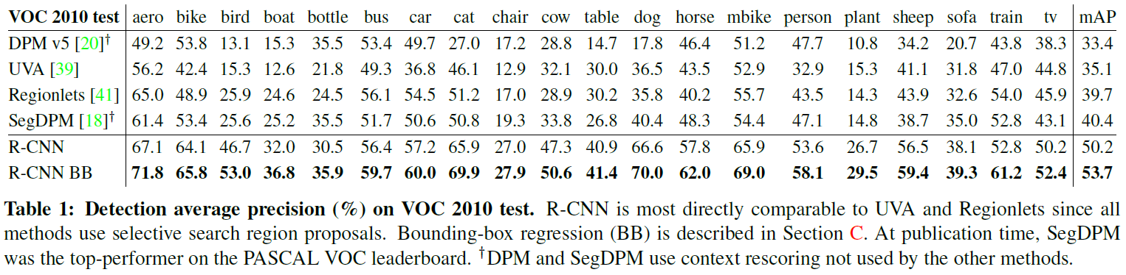
Results on PASCAL VOC 2010-12
We compare our method against four strong baselines
All methods use selective search region proposals

Slide 18
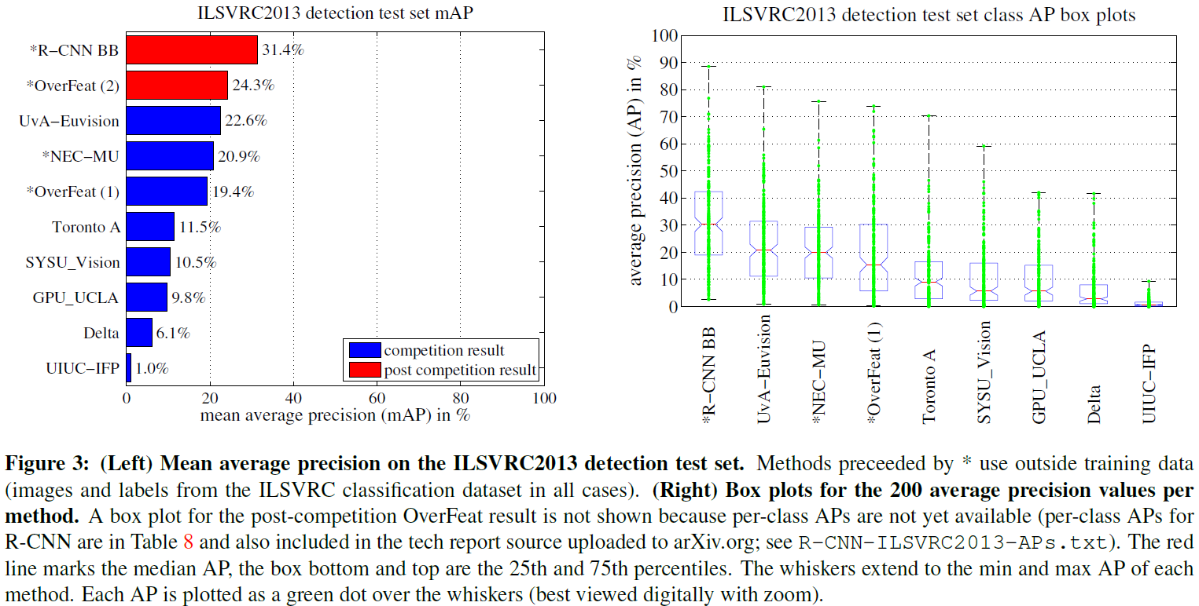
Results on ILSVRC2013 detection

Slide 19
Conclusion
Insight
- apply high-capacity convolutional neural networks to bottom-up region proposals
- “supervised pre-training/domain-specific fine-tuning” paradigm
a combination of classical tools from computer vision and deep learning
the two are natural and inevitable partners.

Slide 20
something to study
cs231n – object detection
EECS 498-007
Other object detection lectures

Slide 21
Thank you for your attention

